Slide 1
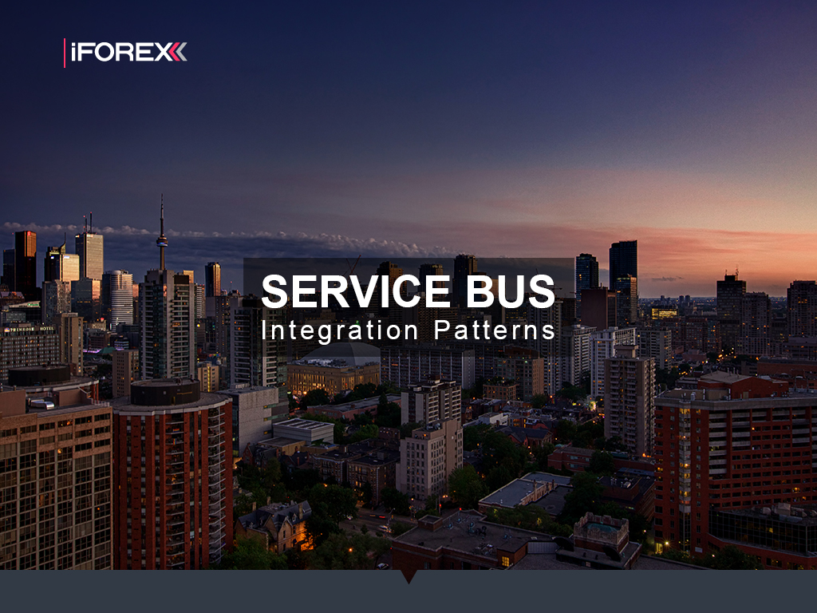
Alex Michel
iFOREX
Silviu Eigel
NESS

Slide 2
Solution
Code
Mass Transit
Mass Transit Stack
Patterns
Transports
Scale-Out
Integrations
Architecture
Availability
Legacy System
Architecture
Problems
More
Explore
Read
Hack

Slide 3
Legacy System

Slide 4
Legacy System Problems
Not Scalable
Hard to split into independent functional parts
Impossible to scale out core components
Parallelism through explicit low-level thread management
No Resiliency
Single point of failure
No means of automatic failover
Waste of Resources
Active Connections
Busy Waiting
Background Threads
Tight Coupling
Strict Imperative Flow Control Code
Components interact via interfaces/abstract classes signatures

Slide 5
MassTransit

Slide 10
Read
https://media.readthedocs.org/pdf/masstransit/latest/masstransit.pdf

